Slide 1
Population Effects of Chronic Wasting Disease
Deer Associates Meeting
March 3, 2017
David Hewitt and Aaron Foley

Slide 2
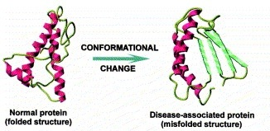
Chronic Wasting Disease
Caused by a mis-folded protein

Slide 3
Chronic Wasting Disease
Caused by a mis-folded protein
Persistent in deer, typically fatal
Progression months to years
Transmissible

Slide 4
Chronic Wasting Disease
Caused by a mis-folded protein
Persistent in deer, typically fatal
Effects take months to years to show
Transmissible
Persistent in the environment
Population effects?
May take years to decades to manifest

Slide 5
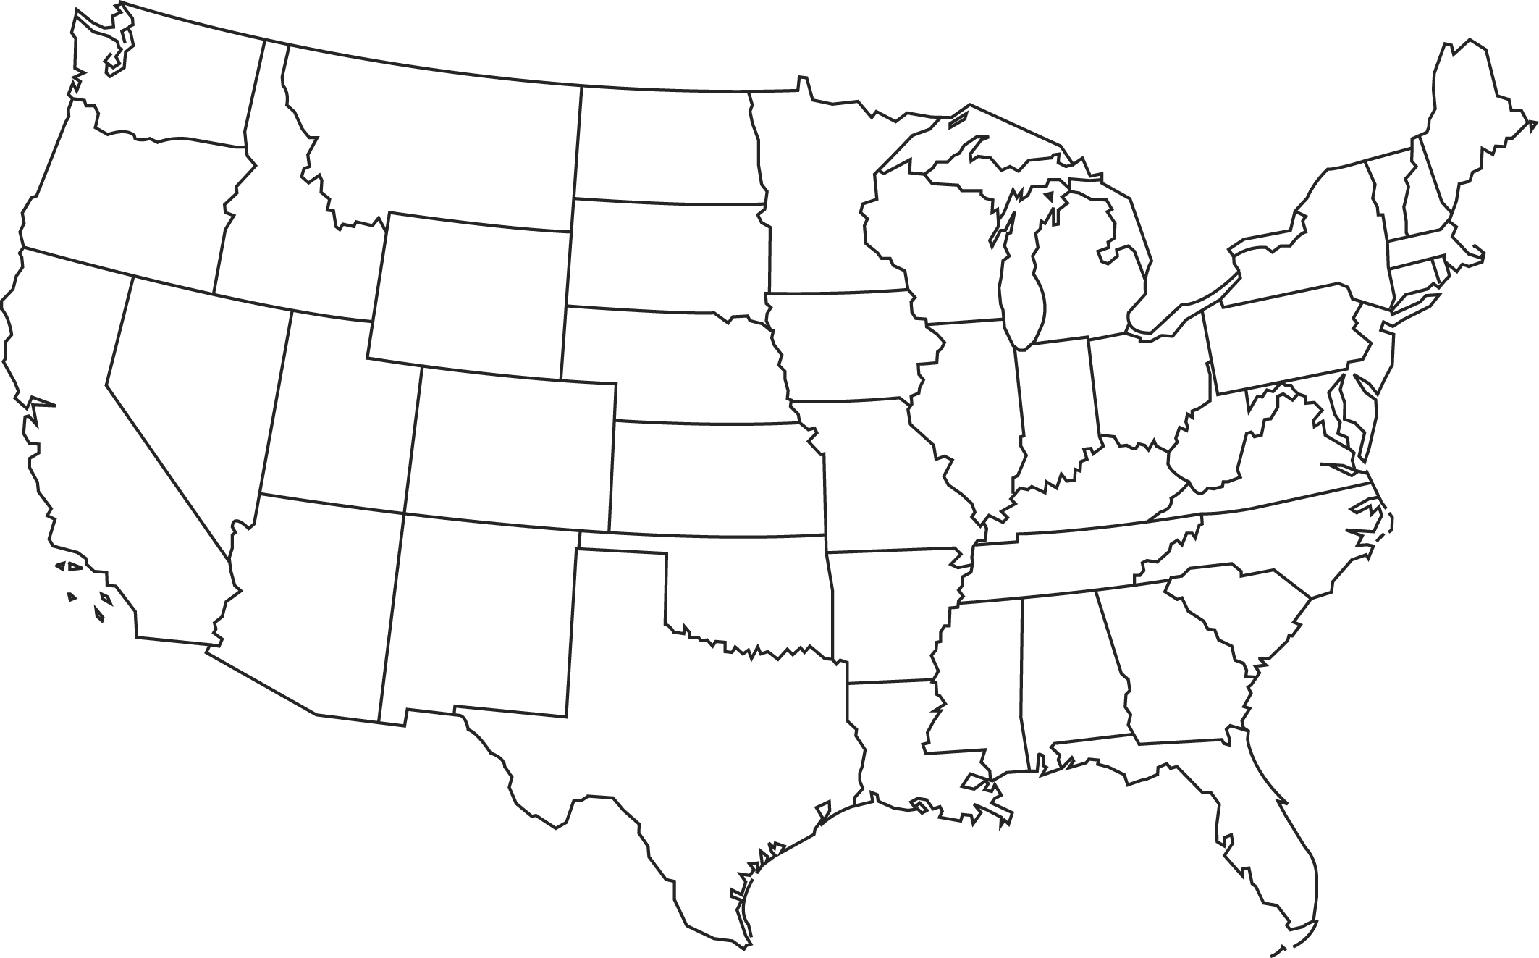
Brief History
First seen in research pens in CO 1960s
Documented in wild in early 1980s
Until 2000, only detected in CO and WY “endemic area”

Slide 6
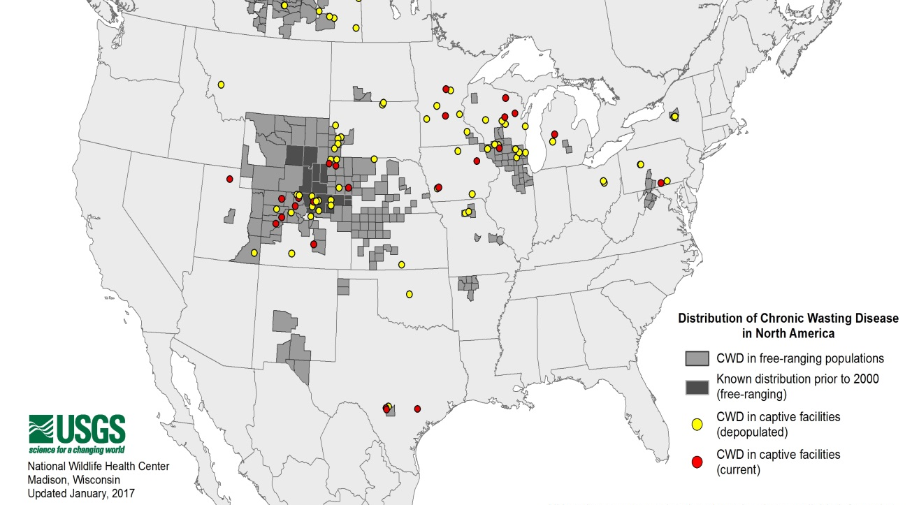
Brief History
First seen in research pens in CO 1960s
Documented in wild in early 1980s
Until 2000, only detected in CO and WY “endemic area”
Big unknown:
What are
population-level
effects of CWD?

Slide 7
Population Effects
Difficult to detect
2 approaches
Measure decline in the population
Cause?

Slide 8
Population Effects
Difficult to detect
2 approaches
Measure decline in the population
Estimate change from recruitment and death rates
?
Recruitment
Deaths

Slide 9
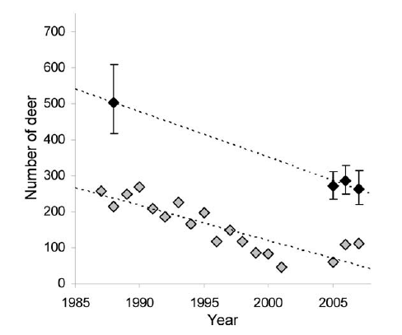
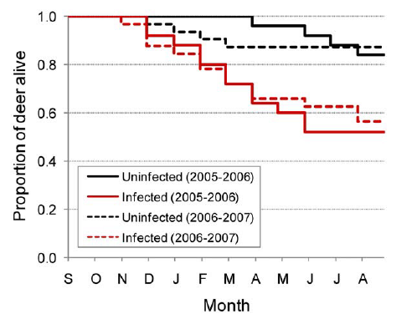
Population Changes
Miller et al. 2008
Table Mesa, CO
Dulberger et al.
2010

Slide 10
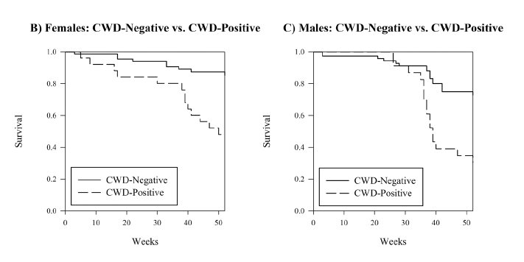
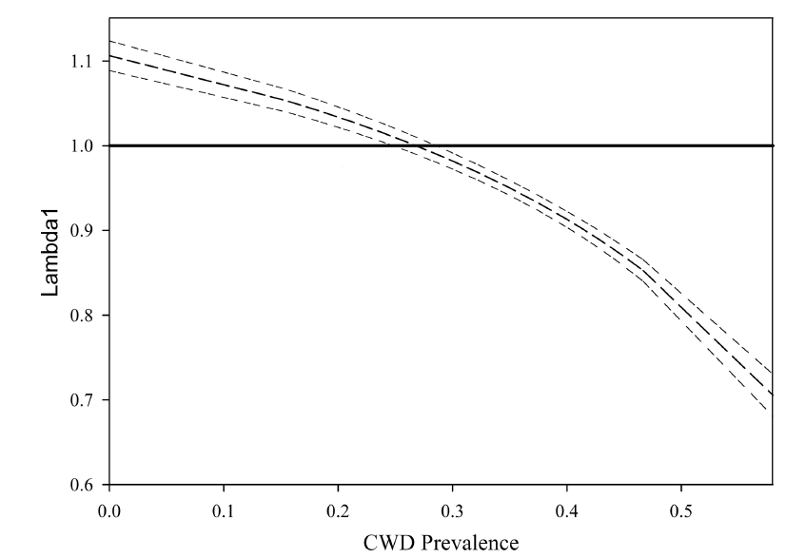
Population Changes
Edmunds et al. 2016
Converse Co, WY
White-tailed deer
Lamda = 0.89

Slide 11
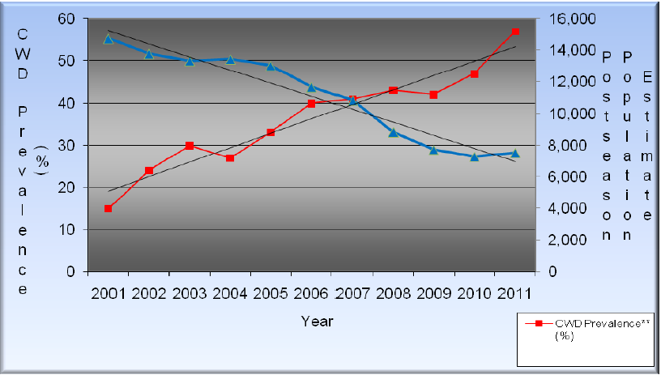
Population Changes
Devivo 2015
Converse Co, WY
Mule deer

Slide 12
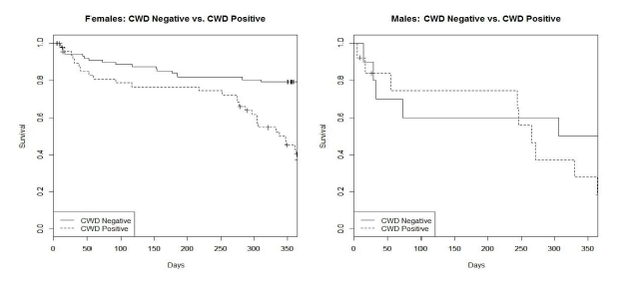
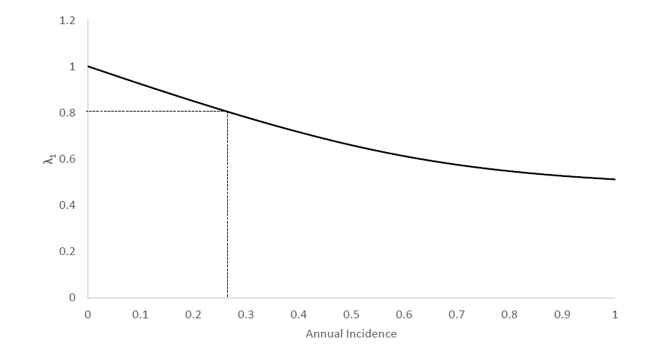
Population Changes
Devivo 2015
Converse Co, WY
Mule deer
31% population decline observed during study

Slide 13
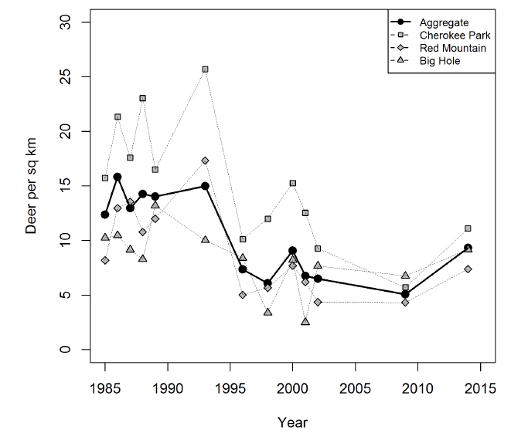
Population Changes
Geremia et al. 2015
North Central, CO
CWD first detected in mid-1980s
Buck
↑ Doe
↓ Harvest

Slide 14
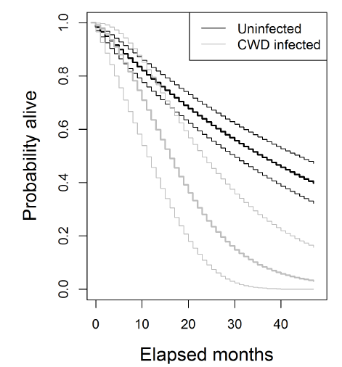
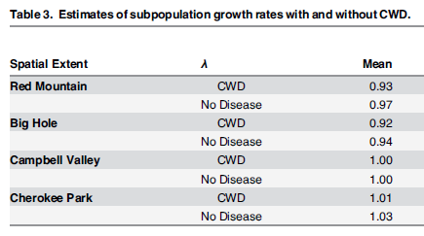
Population Changes
Geremia et al. 2015
North Central, CO

Slide 15
Population Changes
Geremia et al. 2015
North Central, CO
CWD prevalence low and appeared to decline
1997-2002 = 8%
2010-2011 = 4%
Harvest of female deer unsustainable with CWD

Slide 16
Effects of CWD in South Texas?

